Slide 1
CASE STUDY - LEAD SCORING
Member name: Vikul Aggarwal
Member name: Ankit Sahu

Slide 2
Problem Statement
Problem: Help the company ‘X Education’ to select the most promising leads, i.e. the leads that are most likely to convert into paying customers.
Aim: We need to build a model wherein we have to assign a lead score to each of the leads such that customers with high lead score have a higher conversion chance and the customers with a low lead score have a low chance of conversion.
Data: Leads dataset from the past with around 9000 data points. This dataset consists of various attributes such as Lead Source, Total Time Spent on Website, Total Visits, Last Activity, etc.
Target Variable :‘Converted’ which tells whether a past lead was converted or not wherein 1 means it was converted and 0 means it wasn’t converted.

Slide 3

















Problem solving methodology
Python
Data cleaning
Parameter Scaling
Model Building
Predicting on train set
Prediction on test set
Data quality check
Scale the parameters
Perform RFE
Prediction related metrics
Load Data
Prediction related metrics
Removing outliers
Dropping column
Plotting ROC Curve
TPR, FPR, Sensitivity, etc.
Check VIF values
Other operations
Optimal Probability
Check P-values
Assigning lead score
Drop column if VIF>5, p is high
Precision and recall tradeoff

Slide 4
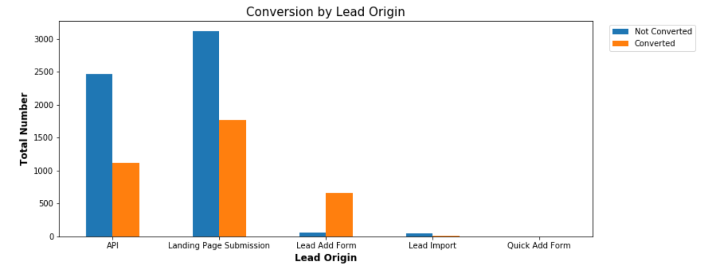
Conversion by Lead Origin
API and Landing Page Submission have low conversion ratio, but high volume. Lead Add form has very high conversion ratio, but low volume.

Slide 5
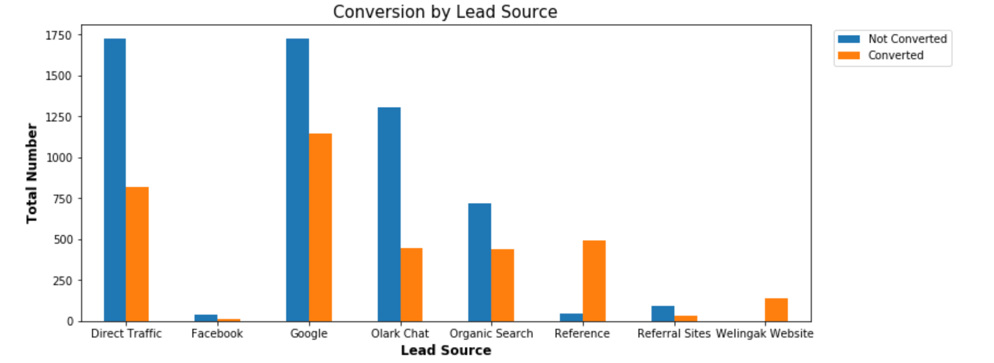
Conversion by Lead Source
Direct Traffic and Google have high volume of lead conversions. Conversion rates of leads through Reference and Welingak Website are high.

Slide 6
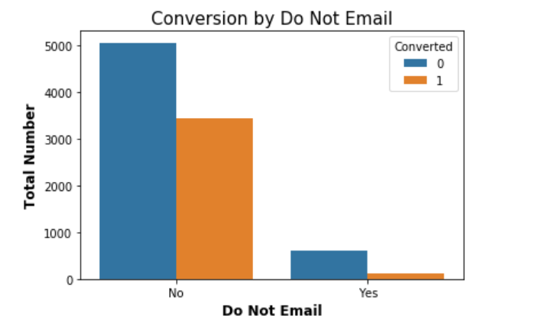
Conversion By Do not Email
Leads who select 'Do Not Email' have a high volume of conversion.

Slide 7
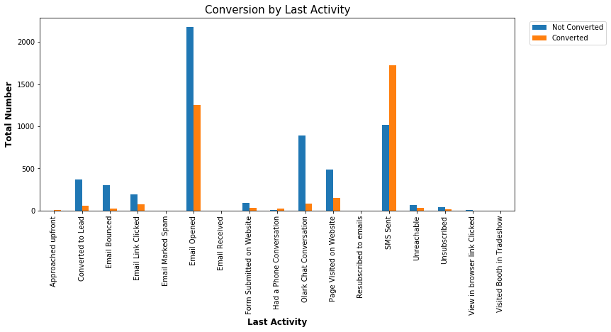
Conversion By Last Activity
Conversion rate for 'SMS Sent' is the highest. Email Opened last activity generates most number of leads.

Slide 8
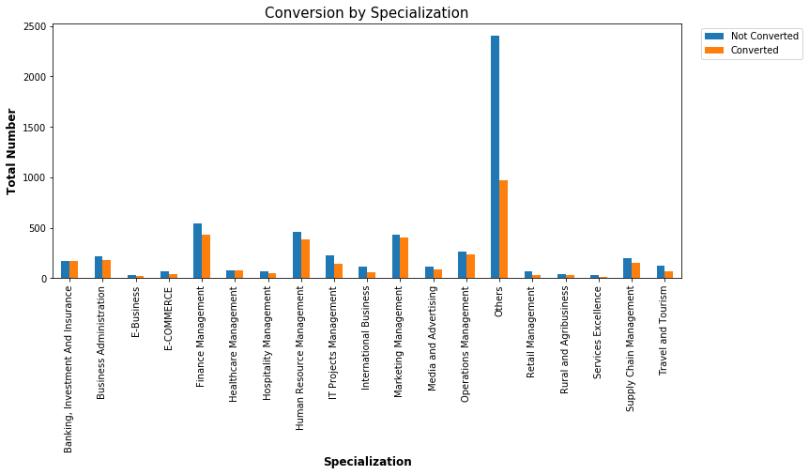
Conversion By Specialization
The conversion volume is the highest for which the Specialization imputed with ‘Others’.

Slide 9
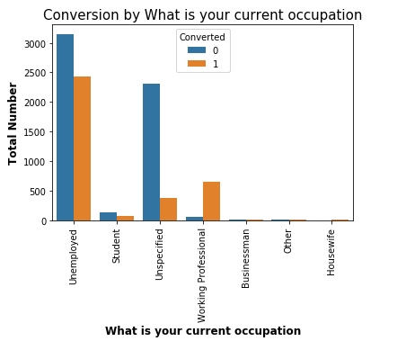
Conversion by Current Occupation
A very high volume of conversions are from Unemployed leads

Slide 10
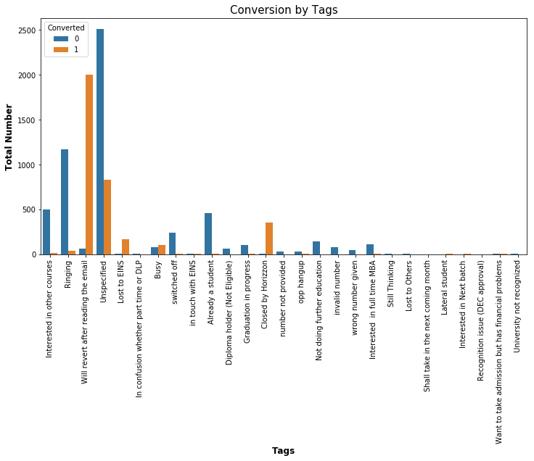
Conversion by Tags
There are some categories like University not recognized, Recognition issue (DEC approval), Lost to Others, wrong number given, number not provided, invalid number etc which almost never convert

Slide 11
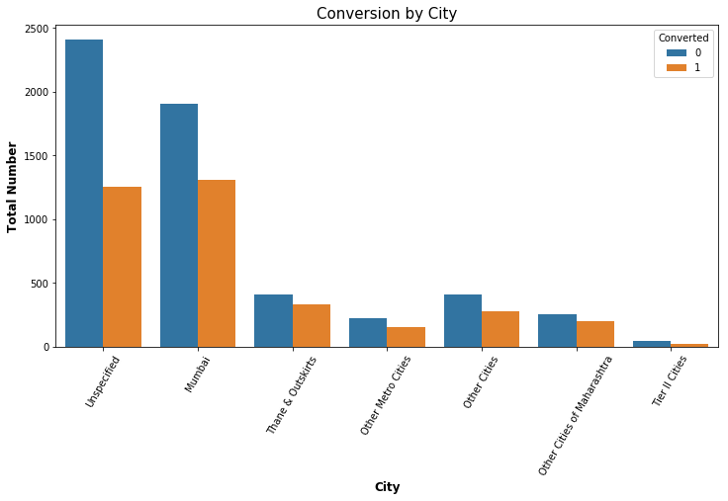
Conversion by City
There seems to be a high conversion rate from Metro Cities like Mumbai in comparison to Tier-II cities.

Slide 12
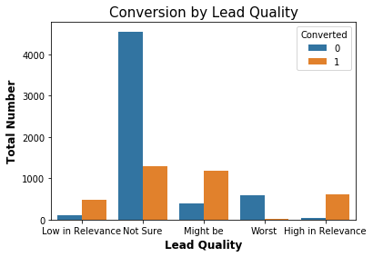
Conversion By Lead Quality
Might be has the highest Conversion ratio. Low in Relevance and High in Relevance have more Converted leads than not Converted. Rest types have low conversion ratio.

Slide 13
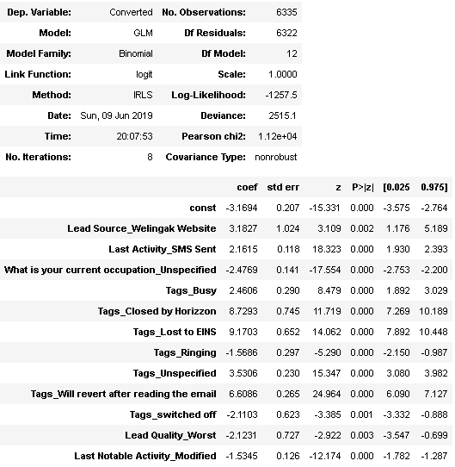
Generalized Linear Model Regression Results for the chosen model

Slide 14
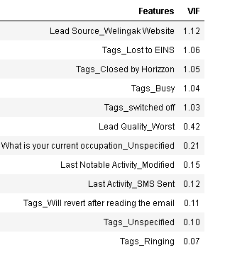
VIF scores for the features retained in the chosen model

Slide 15
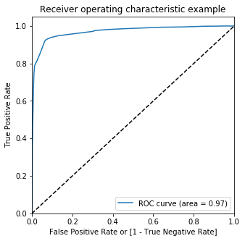
ROC Curve

Slide 16
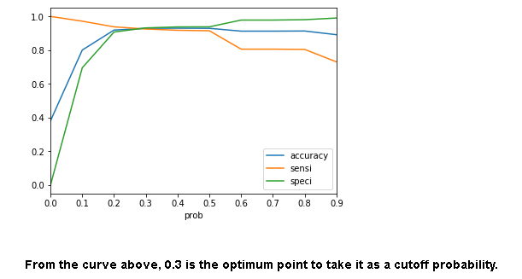
Sensitivity-Specificity Trade Off

Slide 17
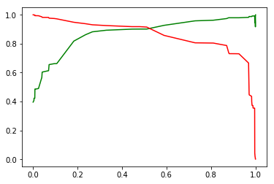
Precision Recall Curve
Precision-Recall Curve gives an optimal probability of ~0.55

Slide 18
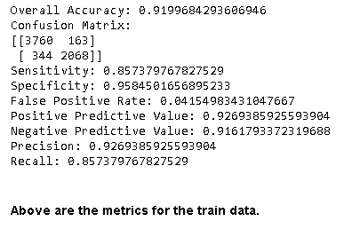
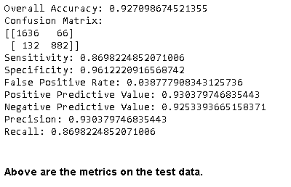
Results and Conclusions

Slide 19
Recommendations to increase lead conversion
Lead Origin - We need to focus more on improving lead conversion of API and Landing Page Submission origin and generate more leads from Lead Add Form.
Lead Source - Focus should be on improving lead conversion of Olark chat, organic search, direct traffic, and google leads and on generating more leads from reference and welingak website.
Leads spending more time on the website are more likely to be converted. Website should be made more engaging to make leads spend more time.
Most of the lead have their Email opened as their last activity. Conversion rate for leads with last activity as SMS Sent is almost 60%. These activities can be tracked for better lead conversion.
Working Professionals going for the course have high chances of joining it. Unemployed leads are the most in numbers but has around 30-35% conversion rate. These two categories should be pursued aggressively.
Leads tagged as ‘Will revert after reading the email’ have a very high volume of conversion, and should be pursued aggressively.
Most leads are from Mumbai with around 30% conversion rate. Leads from Mumbai can be pursued more aggressively after taking their Email/Call preferences.

